Slide 1
CS 171: Final Project Process Book
Eric Slater, Luciano Arango, Monarch Wadia

Slide 2
Overview and Scope
Design and implement a web-based interactive visualization that allows you to answer questions about a topic
Choose the topic to answer questions about
Acquire data
Design visualization
Implement using modern frameworks
Evaluate the results

Slide 3
Project Team
Eric Slater
Harvard Class of 2016
A.B. Degree Candidate in Statistics
Mather House
First Year Programmer (has taken CS50)
Luciano Arango
Harvard Class of 2016
A.B. Degree Candidate in Computer Science
Adams House
Second Year Programmer (has taken CS50, CS61)

Slide 4
Project Team (cont.)
Monarch Wadia
Harvard Extension School Student
Lives in Toronto

Slide 5
Project Milestones
Thursday, March 13: Project proposal due (part of Homework 3)
Tuesday, April 8th, 11:59 pm: Announce your project
Thursday, April 10, 11:59 pm: Functional project prototype due
Week of April 14: Project review with the TFs
Thursday, May 1, 11:59pm: Projects due (including screencast)
Thursday, May 8: Best project presentations and prizes

Slide 6
Motivation
There was much debate in our group about what the main theme of our project should be—we thought about everything from sports statistics to consumer products like cell phones and automobiles to music listening preferences as illustrated in the visualizations discussed in class. All of the above seemed to be niche categories with respect to our group, with only one or two members really excited about them. We finally came around to the Financial Crisis, a topic that is perhaps a bit overplayed. However, one thing that we unanimously noted was the difference in impact that the financial crisis had on different areas around the country. For example, St. Paul, MN seemed to be less much affected than areas like Phoenix, AZ. The entire group is interested in economics and we believe a topic that everyone is attached to would produce a much more effective team.

Slide 7
Primary Objectives
The primary questions we are trying to answer with this visualization are: 1) Is there a significant difference in impact that the financial crisis had on different states in America? 2) Did states see a differentiated response time to the financial crisis in terms of economic indicators? 3) What data best supports the argument that there was a significant difference in impact on states? 4) Can we show unbiased data clearly and concisely, and allow for the audience to both playfully interact with and make concrete conclusions from it? 5) How big of a “wow” factor can we introduce to visitors?
With the accomplishment of all of the aforementioned goals, we would gain significant specific field-knowledge about best-practice visualization portrayal, the usage of D3 and its incorporation into Javascript, and how to efficiently scape all of the related data from the web.

Slide 8
Original Considerations for Data
FDIC Failed Bank List
http://catalog.data.gov/dataset/fdic-failed-bank-list
Quarterly House Price Indexes for Metropolitan Areas
http://catalog.data.gov/dataset/quarterly-house-price-indexes-for-metropolitan-areas/resource/9fb1e508-f257-46c0-b23f-4e3eac0e9a9a
Local Area Unemployment Statistics
http://data.bls.gov/pdq/querytool.jsp?survey=la
Terminated Multifamily Mortgages
http://portal.hud.gov/hudportal/HUD?src=/program_offices/housing/comp/rpts/mfh/mf_f47t
Employment Hours/other data by area
http://catalog.data.gov/dataset/employment-hours-and-earnings-from-the-current-employment-statistics-survey-stat
Low-income Housing problems
http://catalog.data.gov/dataset/housing-problems-of-low-income-households/resource/799c2406-28b9-453d-b736-da6fdb617a00
County Business Patterns
http://catalog.data.gov/dataset/county-business-patterns/resource/2bfcc388-170b-4c60-8b41-addba3bef1d4

Slide 9
What’s next?
Target
Choose domain and research questions
Find and clean data
Translate
Formulate data analysis tasks
Transform and summarize data
Design
Design visual encodings and interactions
Include many sketches
Implement
Use sketches to define data structures
Validate
Post-Project Assessment

Slide 10
Finding and Cleaning Data
We queried data from the aforementioned sources
We anticipated substantial data cleanup and that is what we got
We found the following obstacles in all of our data
Redundant values
Junk data points
Excessive data points for the same thing
Different date-ranged data (ie most were per year while some were every month)
Different collection areas (ie some were state-wide, some county-wide, some city-wide)
Parsing the data was also much more difficult than we expected

Slide 11
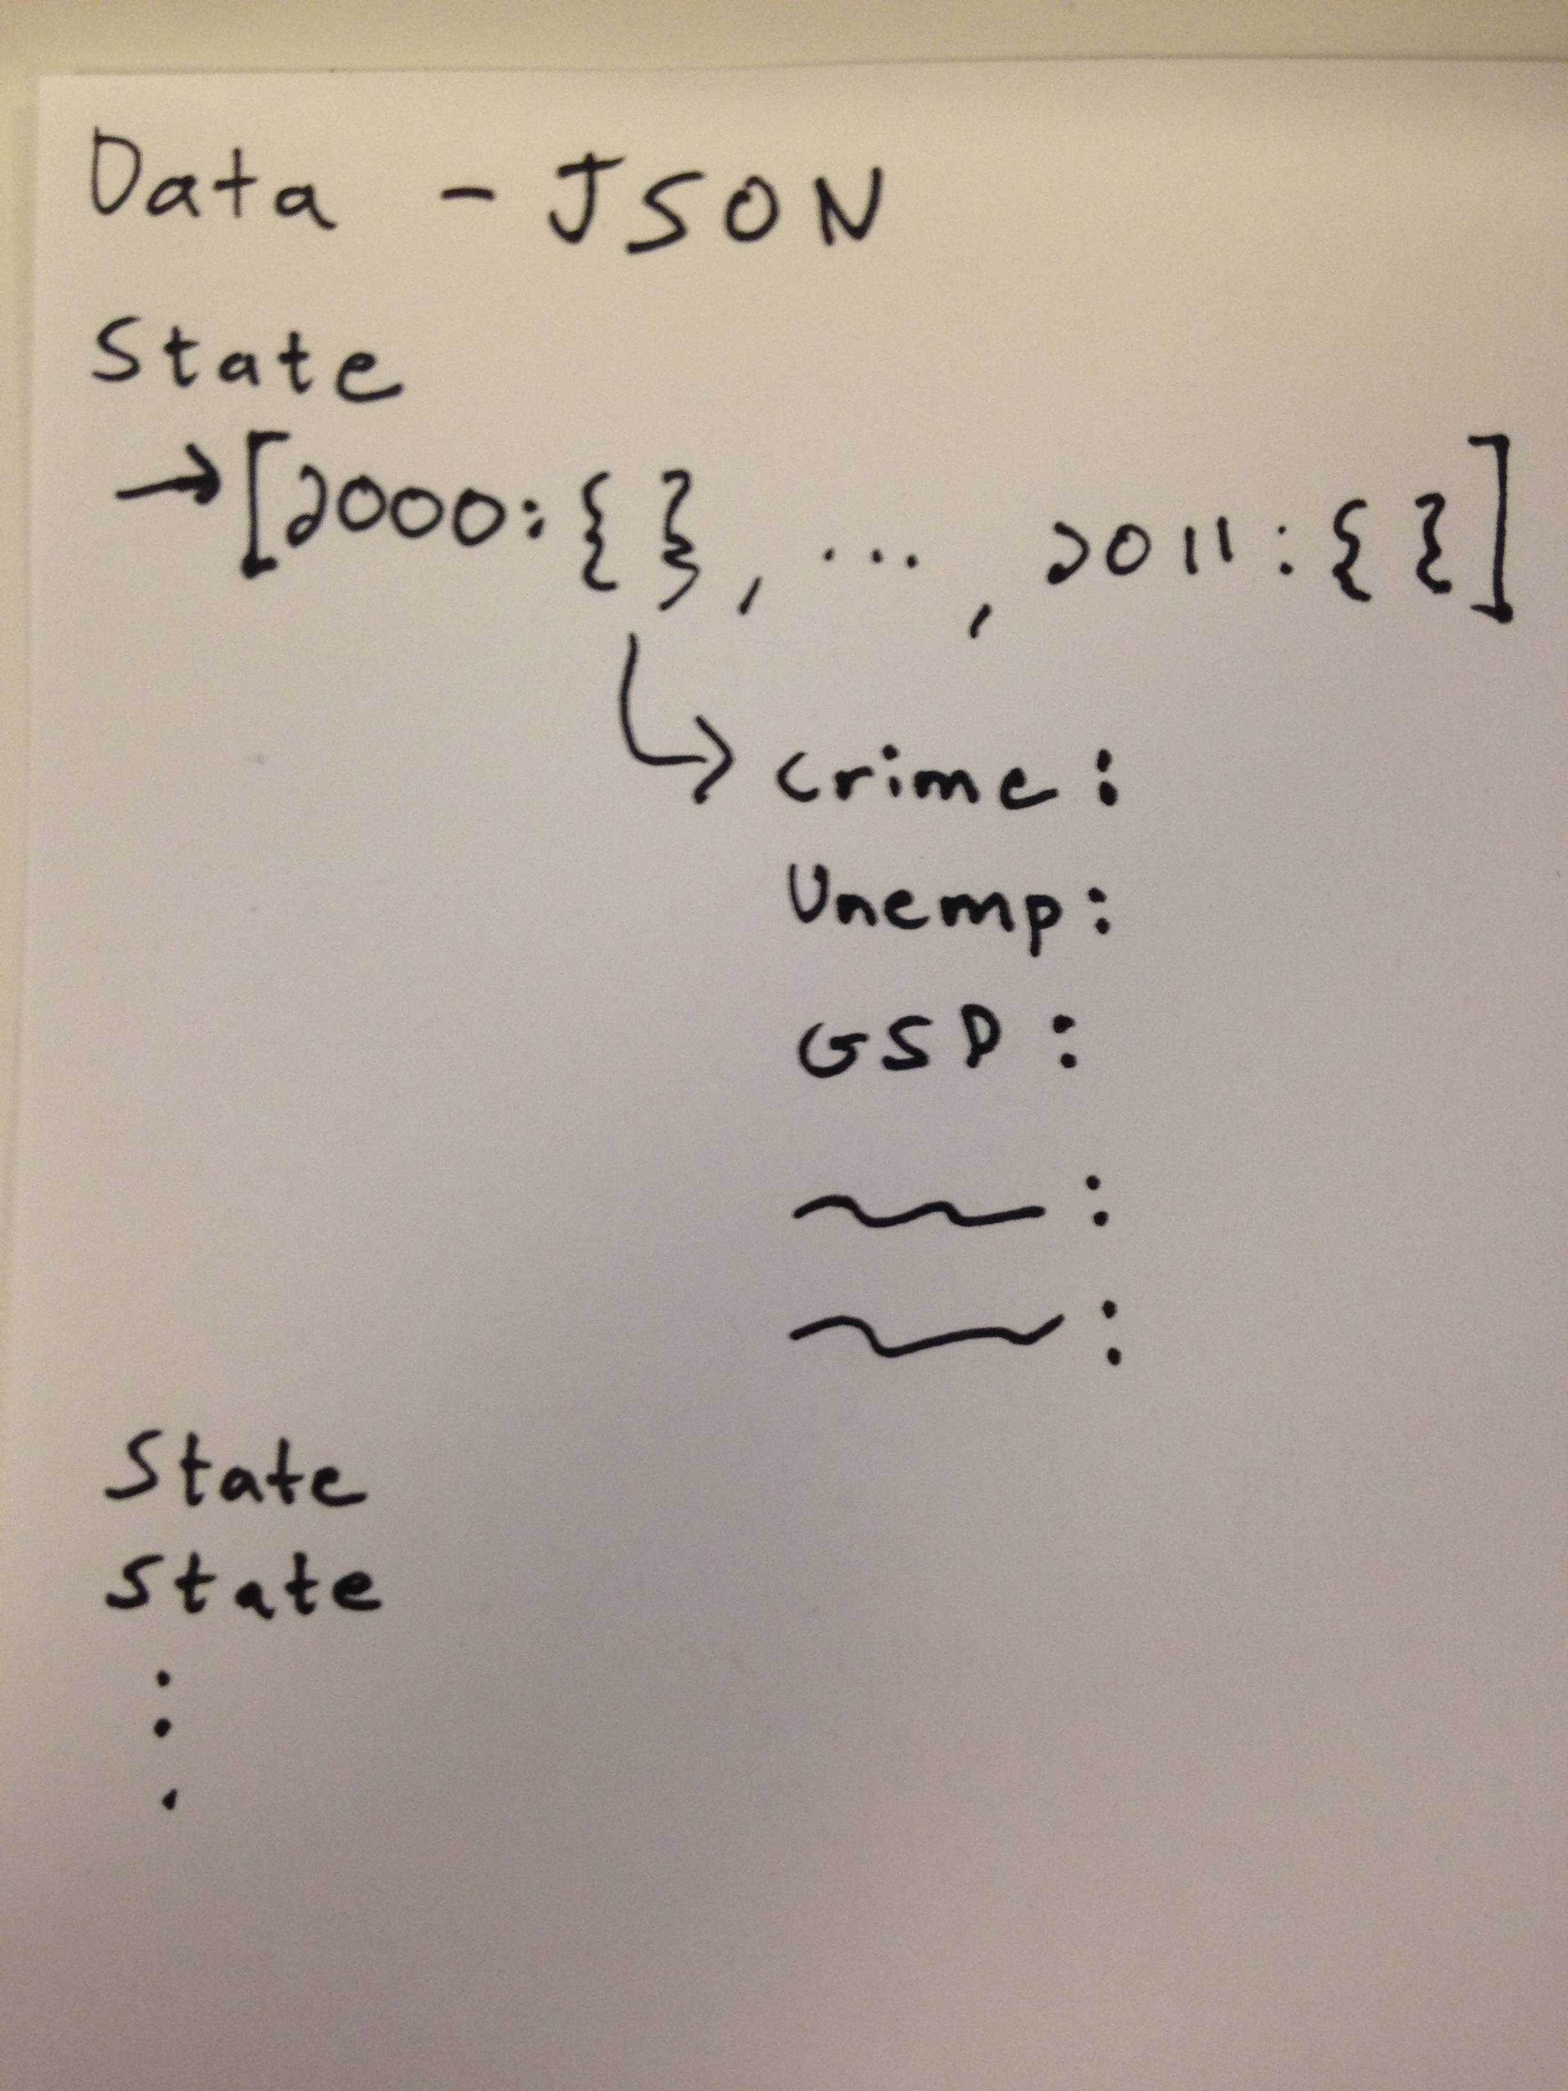
Parsing Data
Our initial scope included a dataset with many different economic indicators for each state per year
We decided on a JSON reduction of data size as seen in Problem Set 4
The initial structure was based on the following sketch:
Object for each state
Array of years in each state
Each year would be a key for another object
Economic indicators would be here

Slide 12
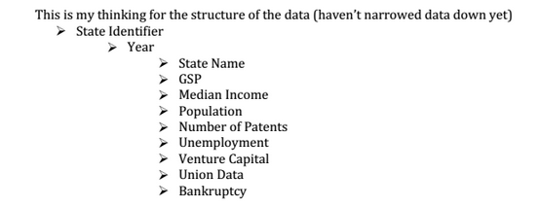
The Next Data Structure
We decided on a more object oriented process after running initial JSON directors
Object for State
Object for Year
Key: Values of every indicator

Slide 13
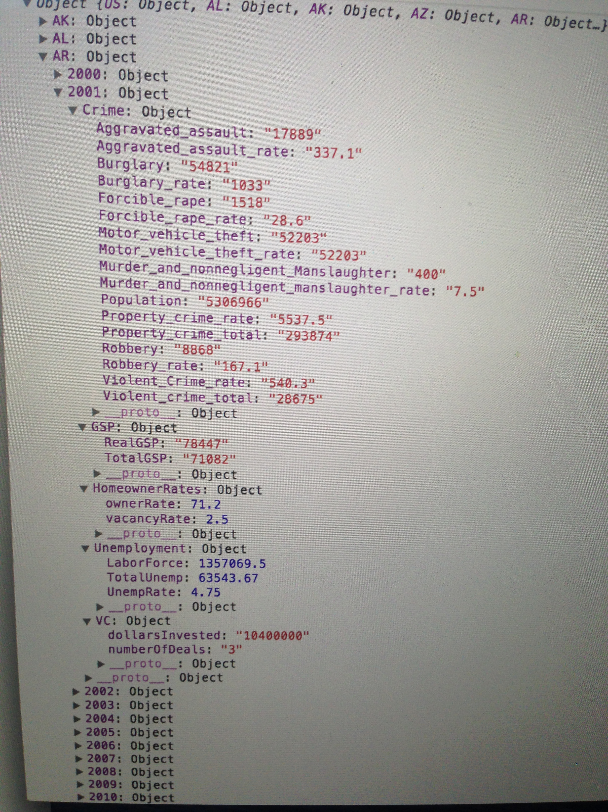
Final JSON object format
Objects of indicators inside
Crime
GSP
Homeowner Rates
Unemployment
Venture Capital

Slide 14
Normalizing Data
Crime
Aggregate data
And rates per 100,000 people
Gross State Product
Divided by population to get per capita
In Real and Total terms
Homeowner Rates
Rate out of 100 for owning a home
Vacant homes per 100
Unemployment
Unemployment Rate
Total number of people Unemployed
Total number of people in the Labor Force
Venture Capital
Number of deals and dollars

Slide 15
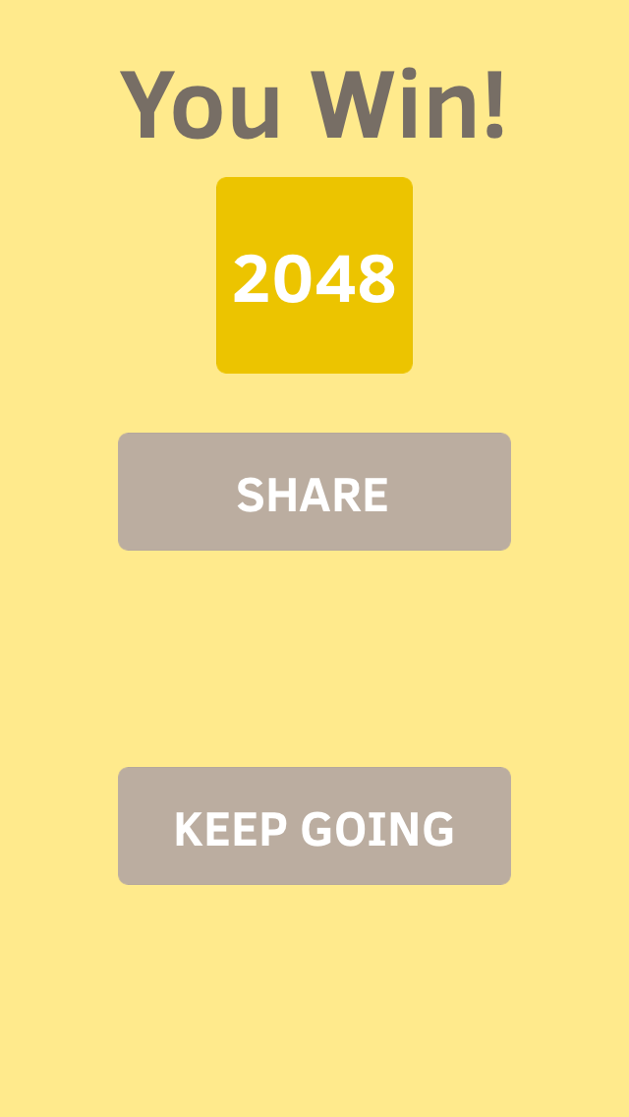
Some Mandatory Procrastination Before Design

Slide 16
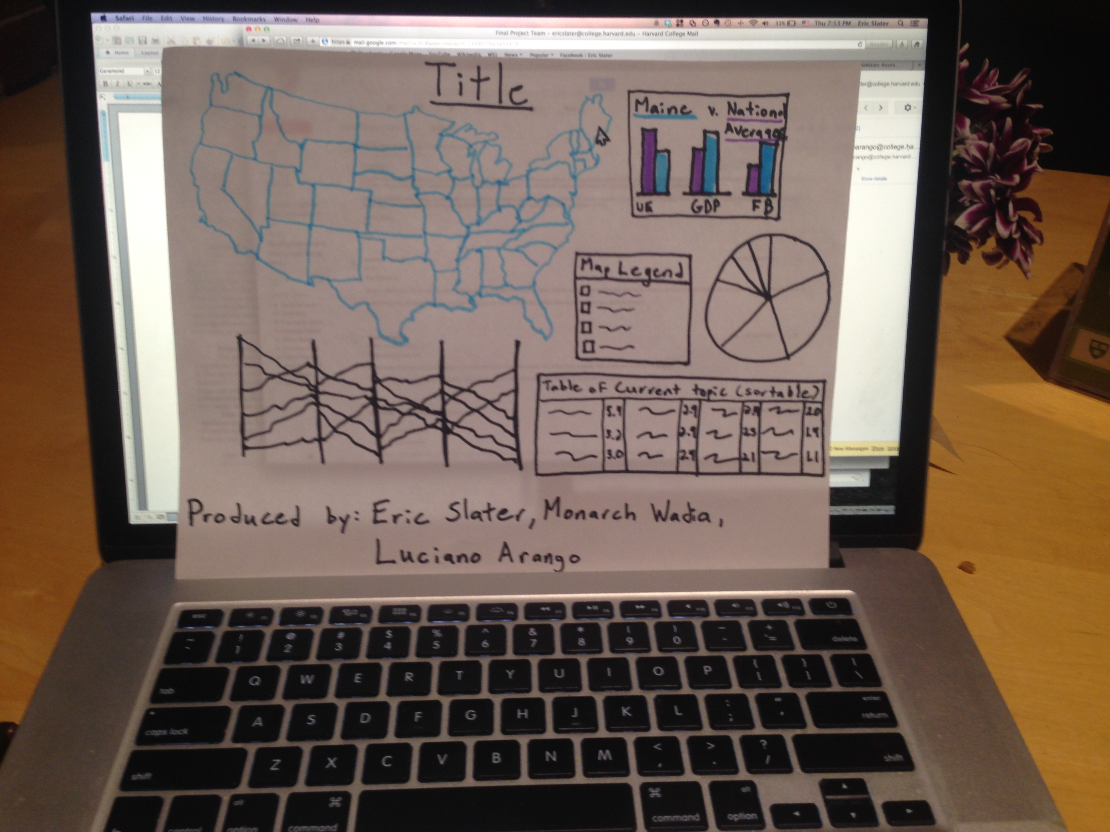
Translate
Our original outline for displaying the United States in indicators during the Great recession:

Slide 17
Original Scope (before HW3)
Must Have Features
A central, interactive Chloropleth map of the United States
An interactive visualization of some shape/form that portrays individual state data (preferably something that loads as you scroll over a state)
Optional Features
An interactive Parallel Coordinate visualization to compare states in different categories.
An interactive Hierarchical Edge Bundling that shows connections between different states, times, and/or specific economic indicators.
Cool Javascript tour of our website and how to do certain interactions with it

Slide 18
Unfortunately, we did not know that we would be implementing something similar on Homework 4…
Feedback on our initial Proposal:
“You do seem to be a bit ambitious / disorganized here -- you seem to put forth a lot of nonrelated goals, but if want to accomplish all of them that's great”
Our Assessment: Our original picture did seem a bit cluttered. Initially we want to remove the pie graph from scope. Additionally the table of current indicators would be a good thing to scale back on.
Further evidence “It might be worth considering a better way to 'organize' the different visualizations that you would like to use. The line between a cool 'dashboard' of information and a disorganized agglomeration of different visualization types is a thin one. I would recommend discussing internally a way to organize the visualization so it comes across coherently”

Slide 19
Further Feedback
“Your must-have features seem a bit too limited. A chloropleth map, especially given the last homework, will be very straightforward (as will a simple hover tooltip). I'd recommend you move one or more of your optional features into your must-have list.”
Assessment: We were not aware of the chloropleth portion of Homework 4 as it was not yet released when we turned this in. So off the bat we are thinking about ways to spice our visualization beyond a map.
Further Evidence: “I do want to caution you from doing too little in this cause because of the popularity of your topic and the scope of the homework 4”

Slide 20
Considering Examples
With our scope under construction we reached out to the internet for further examples of good visualization technique and creativity
The first visualization we considered was the winner of last year’s projects
https://googledrive.com/host/0B956l87SY0KpRUdrX19TUDhXb1U/index.html
Having talked about Parallel Coordinates and already in our scope, we thought it would broaden our horizons to add a brushable version that would remove color from unselected states on our graph.
Turns out our TF was of the same opinion “I think having a linked parallel coordinates brushing graph would be a great idea.”
We then turned our attention to a less interactive version of mapping state data
http://www.pewstates.org/research/data-visualizations/financial-crisis-5-years-later-and-still-not-recovered-85899502641
Another graph dealing with the financial crisis, but breaking up the states into regions and having the simple user interface of adding and removing regions

Slide 21
Further Scope Considerations
“I still am a bit concerned about the scope of your choloropleth (given that is resembles somewhat the bonus of the last homework). While I understand that the data is not given a priori; it might make more sense to narrow your project to detailed information for a particular dataset and then be able to 'dive down' into a particular state”
This was definitely a tough thing to hear from our TF
But understanding his concerns we started to think about new directions to take our project
After discussing with many other TFs during Office Hours and after lecture we realized that we had quite a challenge on our hands
Display 5 different sets of data, for 50 states, over a period of 10 years
One might be thinking 3D at this point! But we knew better

Slide 22
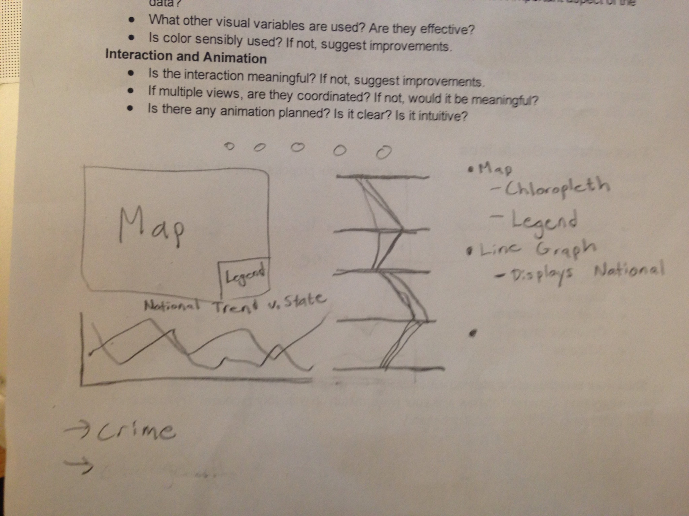
A Solution Sketch 1

Slide 23
A Written Solution
Map
connected to parallel coordinates
connected to line graph
shows one data point at a time that is selected by user
Chloropleth - hooked up to a selector on the x-axis of line graph
Map Legend
dynamically changes as data changes
Line Graph
x-axis -- year
y-axis -- indicator scale
always displays national average
click on a state to display it as well
Indicator Selector
radio buttons or something similar to select one of five data points
Parallel Coordinates
Brushable
axis -- each indicator
displays states with chloropleth color
national average also displayed, in a unique differentiating color
all in all its main purpose will be as a brushing tool
Stats at a glance
allow user to see all indicators for a selected state in relation to the national average
completes the goal of displaying a readable version of all indicators
This will be for a given year, which will be picked with a selector hooked up to the x-axis of the line graph

Slide 24
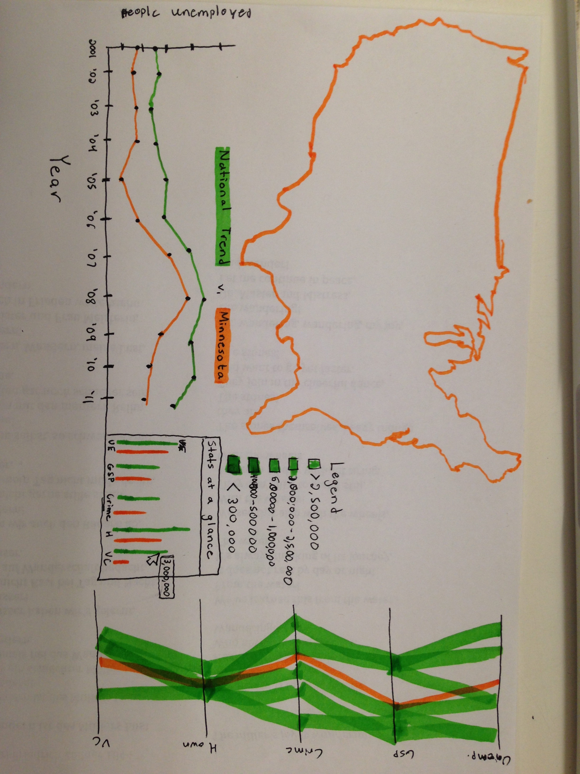
Solution Sketch 2
“I do appreciate the increase in scope and think it is more appropriate for the final project”

Slide 25
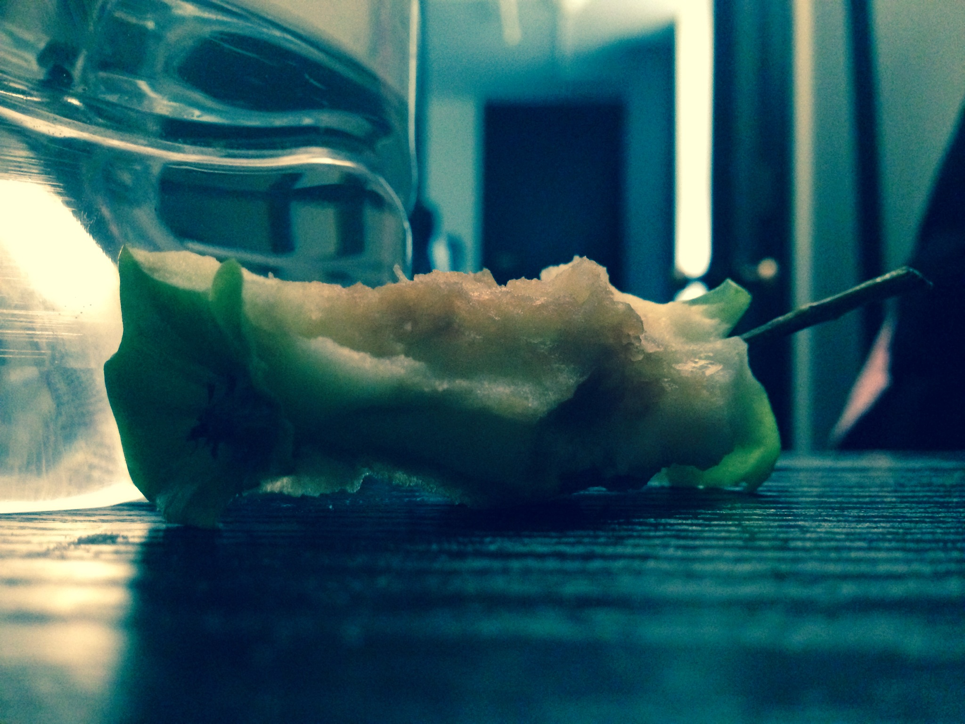
Daydreaming about possible solutions I took the following noteworthy photo

Slide 26
Considerations
We are scanning visualizations in reading order and are attracted to titles, text, and labels
Put titles at the top left and put labels and textual explanations close to the visualization
Our visual system sees differences, not absolute values, and is attracted to high-contrast edges
Maximize contrast between visual elements to make them stand out and avoid busy textures
Draw the user’s eye to the most important part of the visualization
Provide a visual hierarchy of information that will help make it clear to the user how they should interact with the information
We can easily see objects that are different in color or that are in motion
Use color and motion sparingly to make the important information pop out

Slide 27
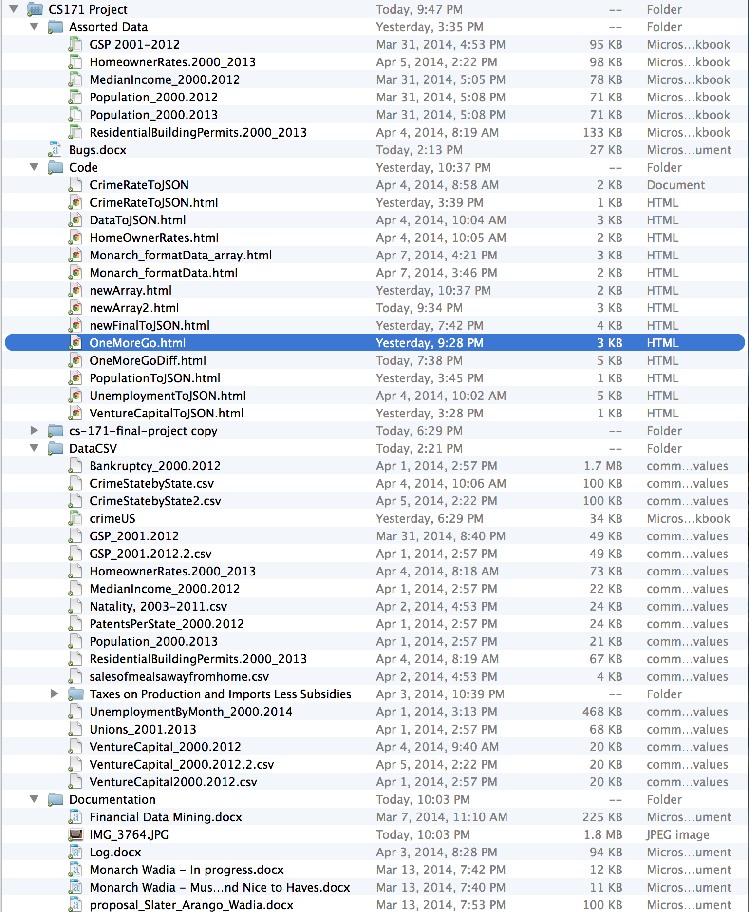
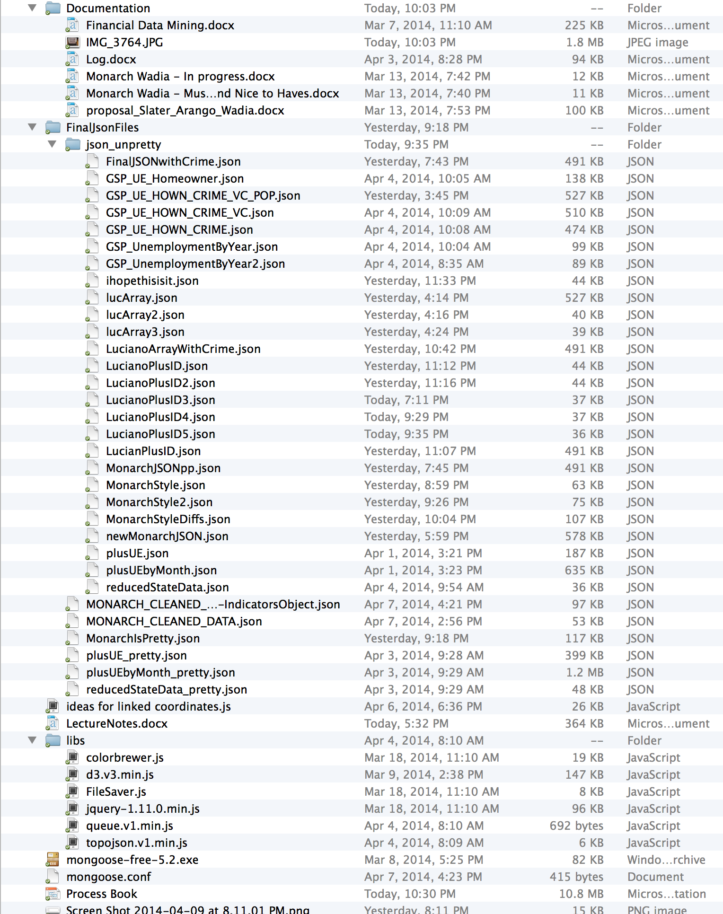
Implementation

Slide 28
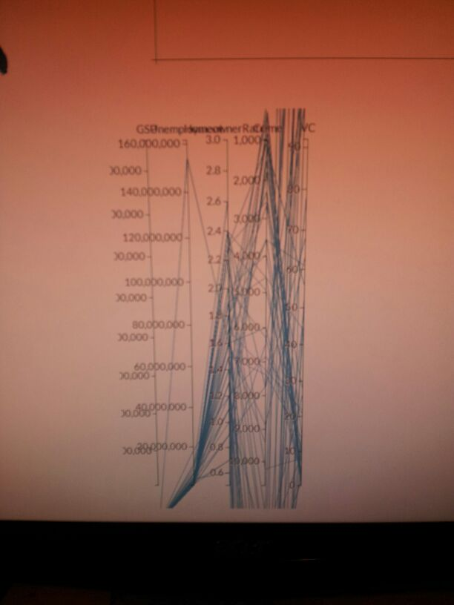
Parallel Coordinates
Shows primarily relationships between adjacent axis
Clustering & aggregating records
Transparency of lines
Interaction is crucial
Axis reordering
Brushing
Filtering
Our first attempt was somewhat fruitful!

Slide 29
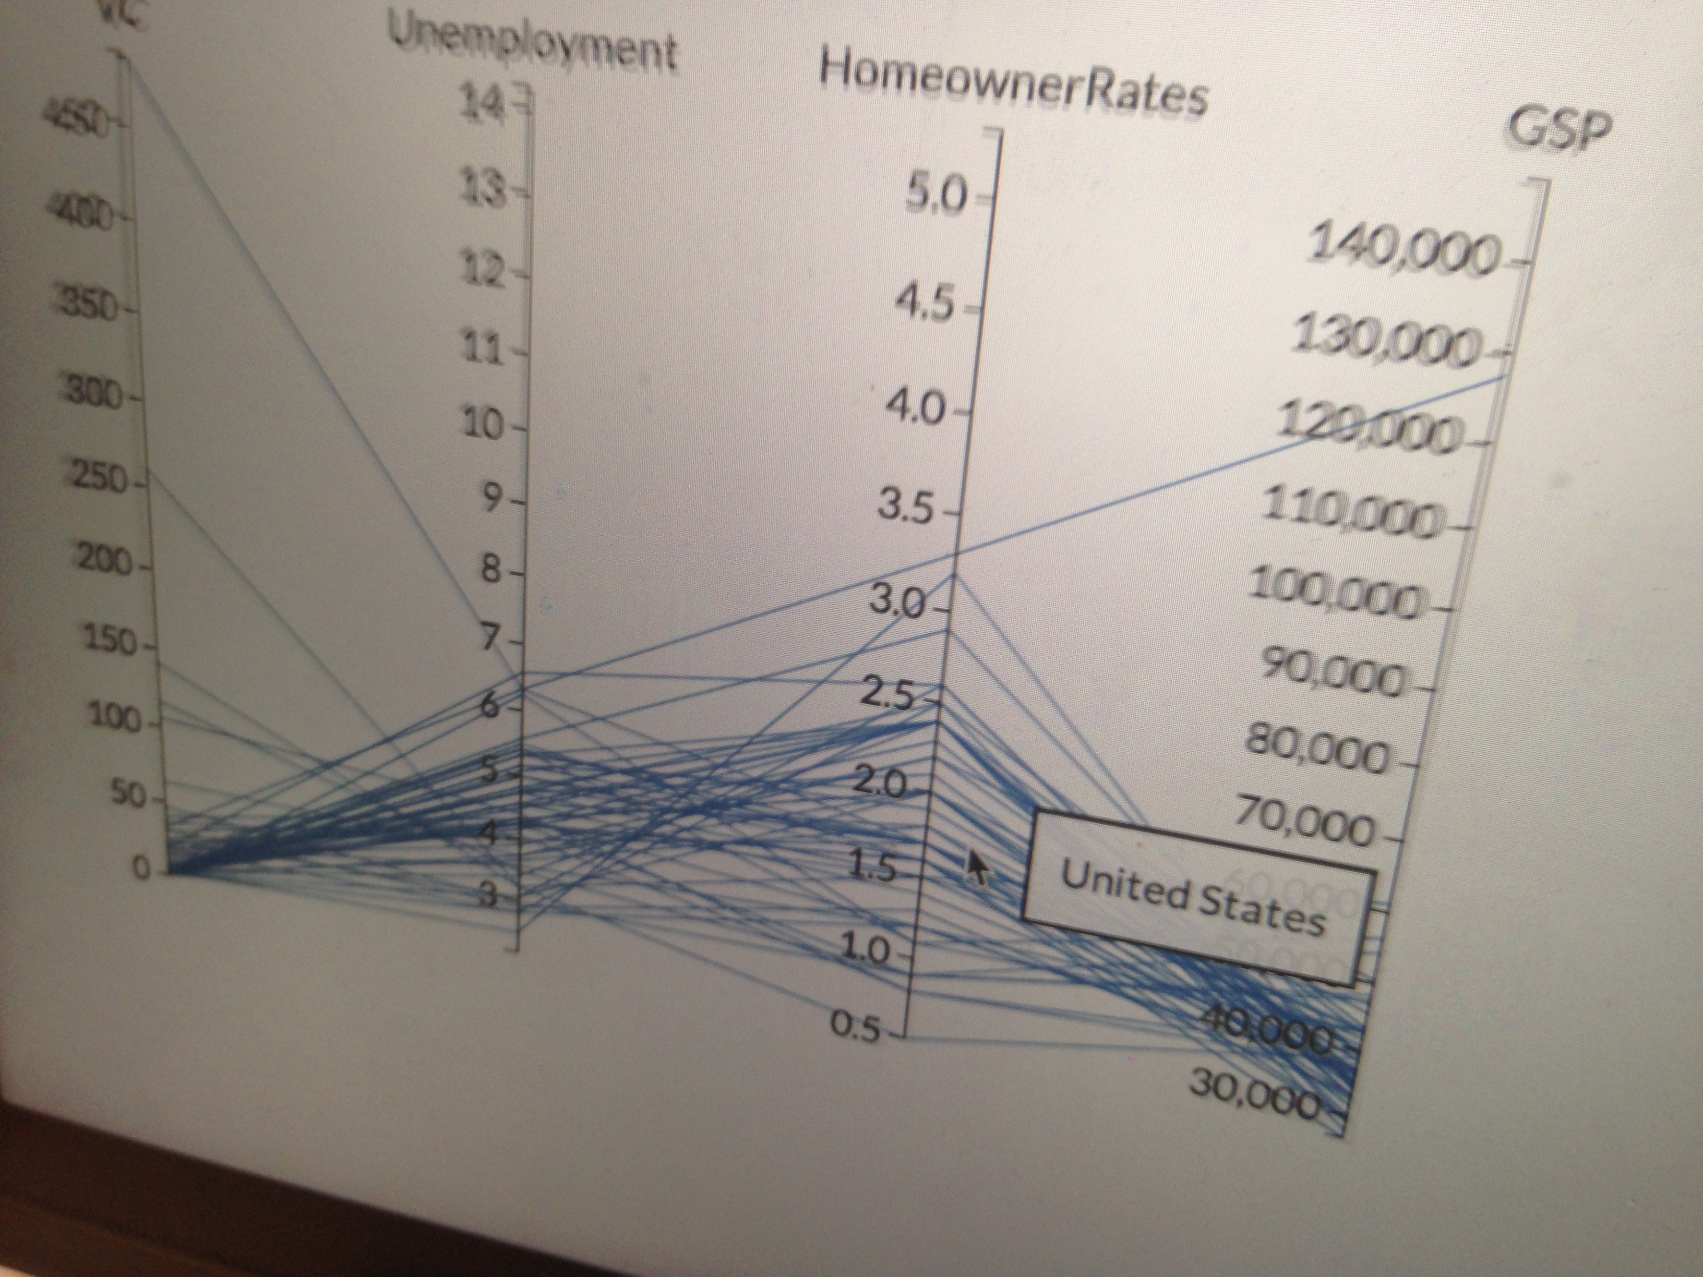
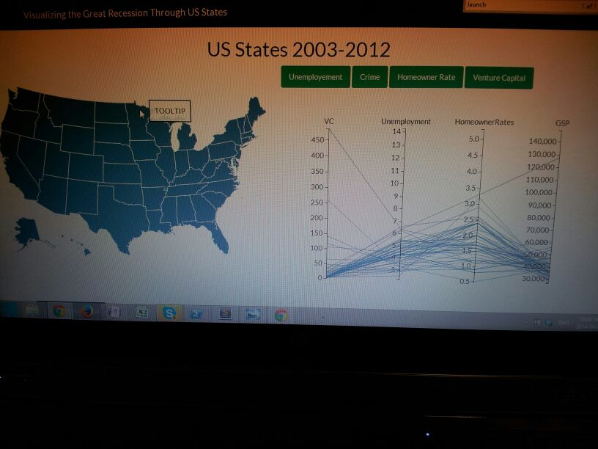
Parallel Coordinates Take 2 (&3)

Slide 30
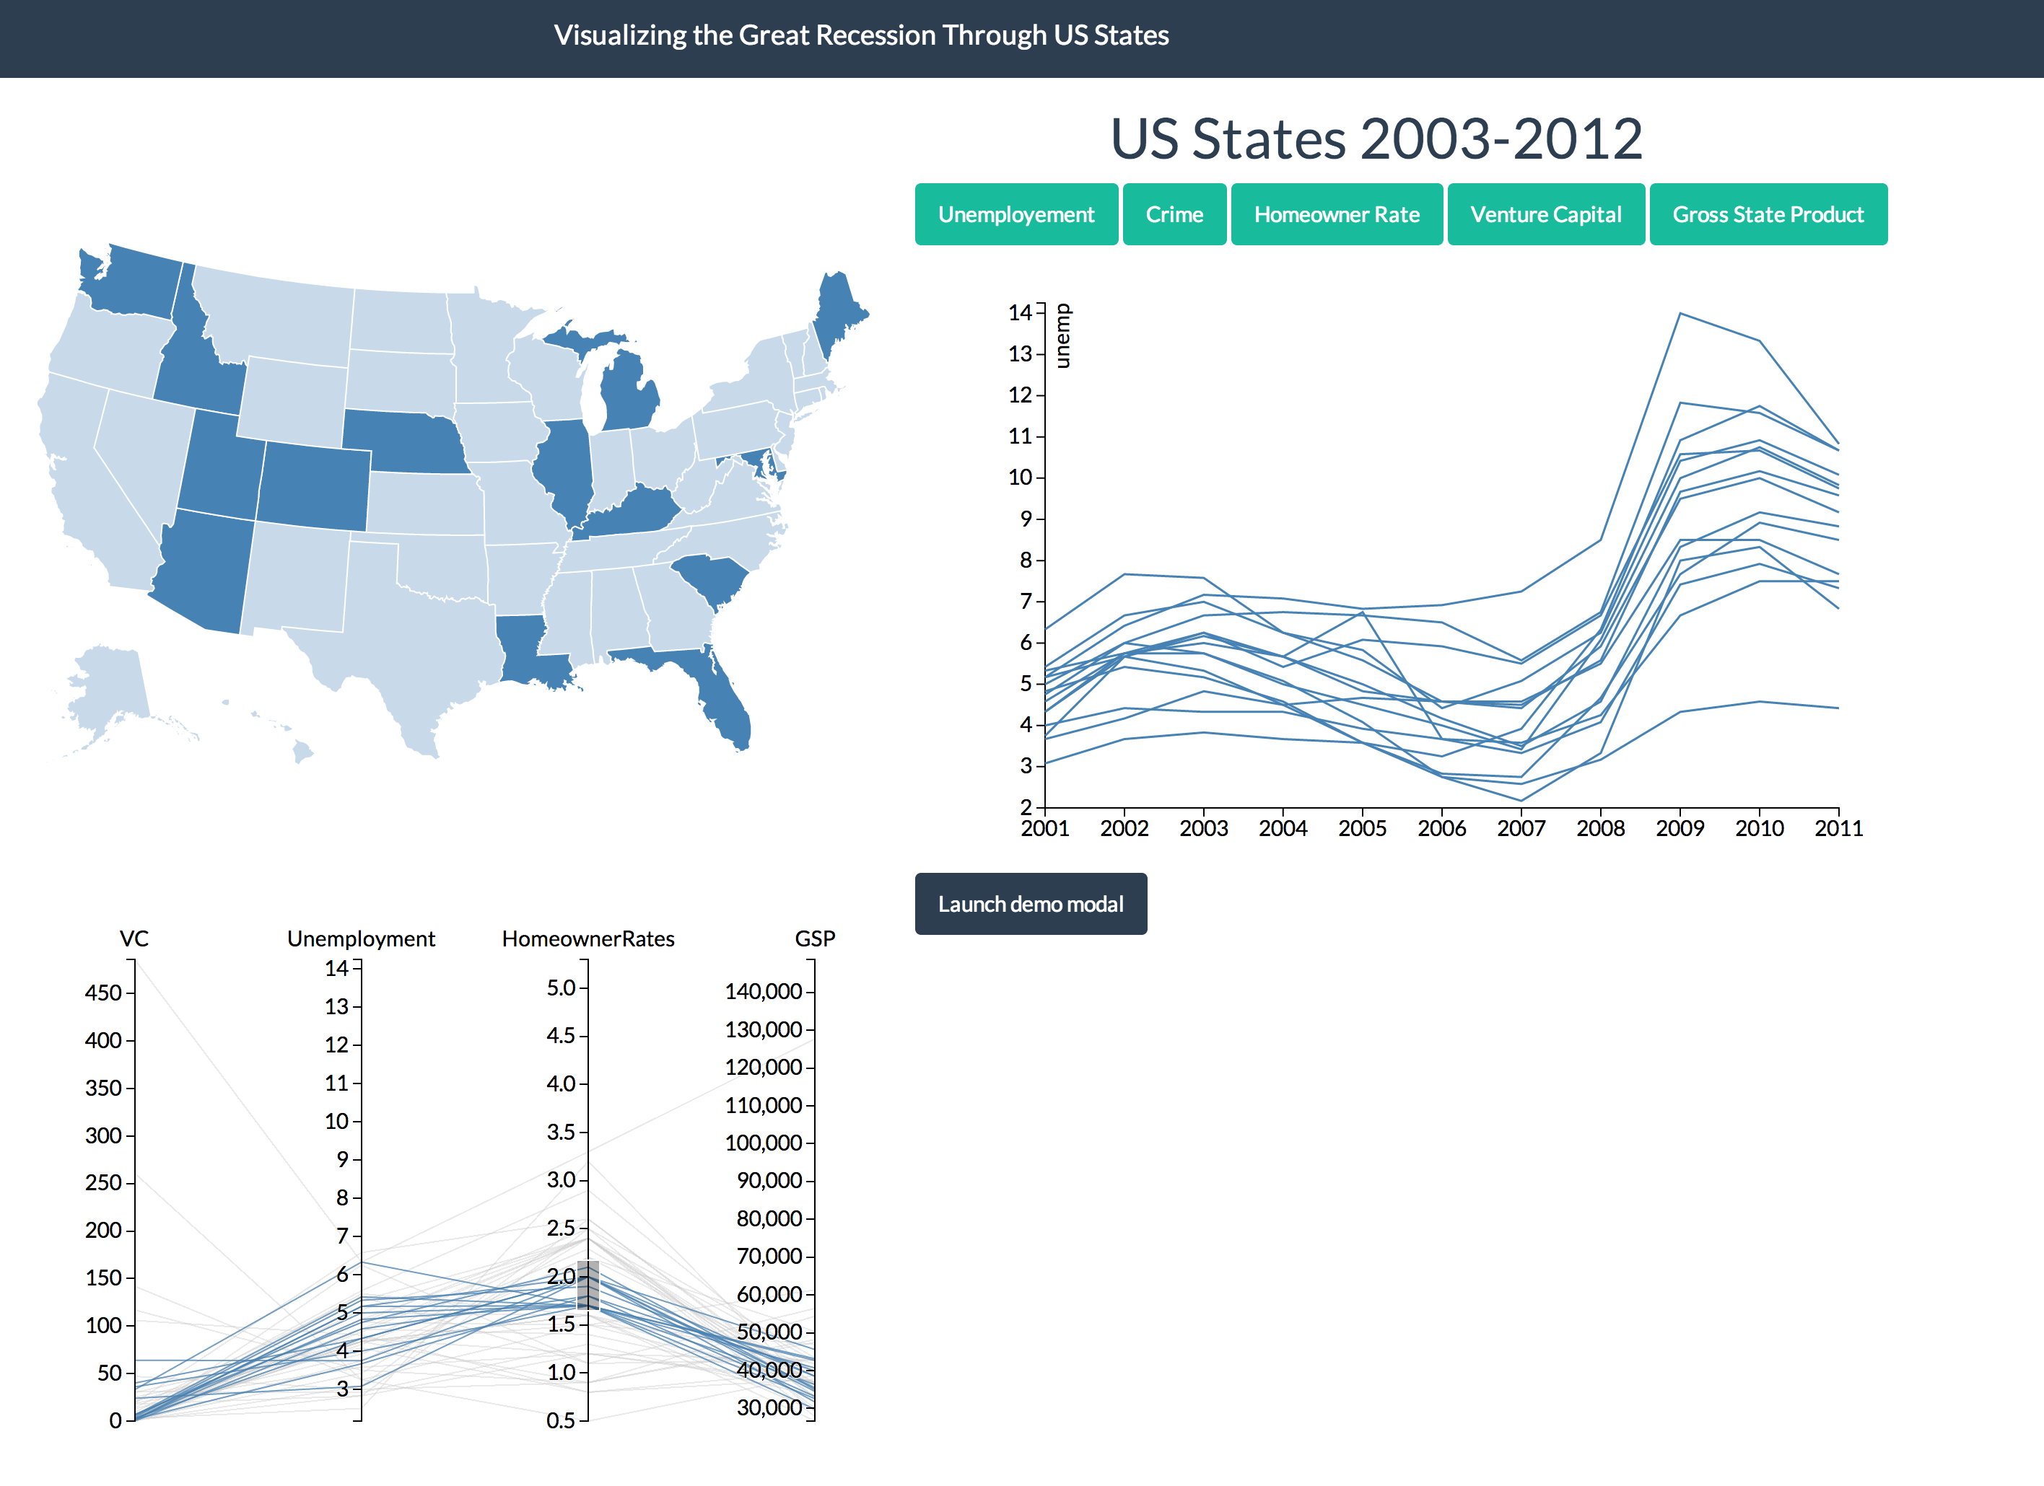
A Line Graph
But not just any line graph
We want interactivity with both the map and the Parallel Coordinates
Usually displays 50 lines (one for each state)
Gives us a time range from 2001 to 2011

Slide 31
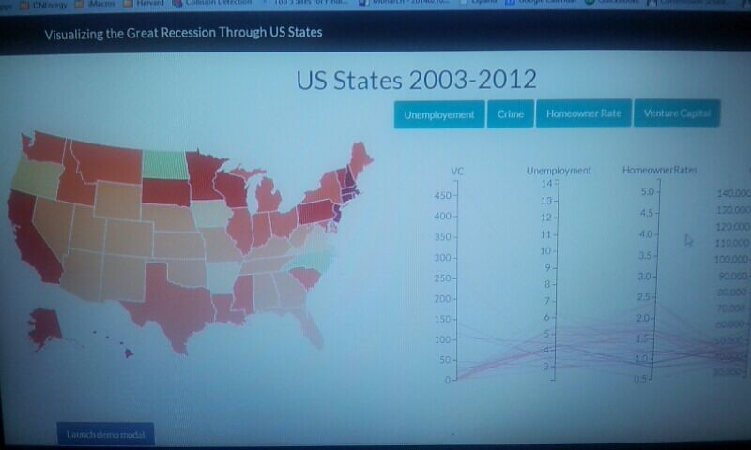
Enter Chloro
Still working on the color scheme…

Slide 32
A list of other details to include in next process book
Data
There was a constant re-arrangement of data into different arrays and objects to make all graphs work in sync
We are thinking about changing some of the data indicators, as it seems that it is harder to see a correlation than originally thought for some (data was parsed in STATA before entering it)
Literally spent more time on data manipulation than the coding so far
Design Decisions
Many design decisions were made along the line that are not discussed in depth here. When we near completion, I will better be able to elaborate on how these impacted our final product
Scope was a major setback for us given that Problem Set 4 dealt with our chloropleth ideals. However, we have arrived at a solution that goes above and beyond such simple ideas as projecting a map and coloring it.

Slide 33
Where are we now?
US Chloropleth Map hooked up to five different sets of data controlled by the parallel coordinates.
Parallel Coordinates that are brushable and that affect our line graph and map when brushed.
A Line Graph for a specific indicator and any selected states over the time period we are observing.
Highlighting functionality within the Line Graph
Buttons that change the indicator of interest
Tooltip that displays the name of the state selected

Slide 34
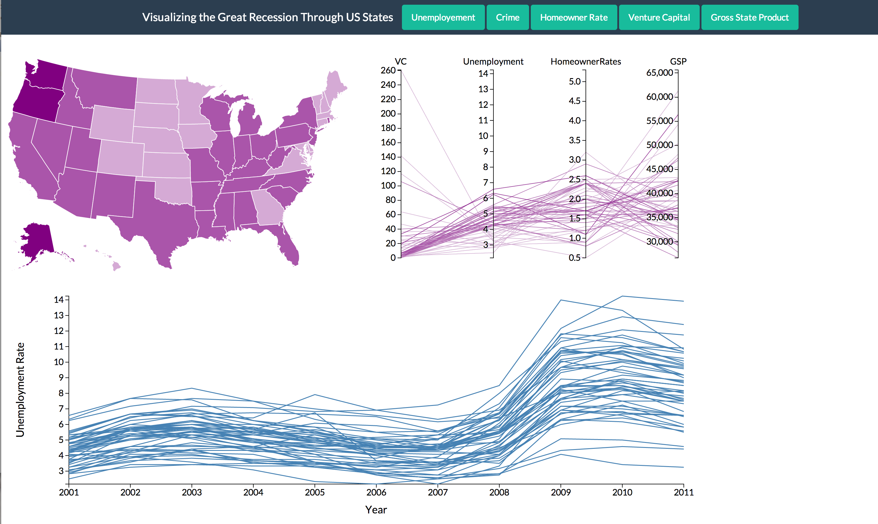
Here

Slide 35
Where are we going?
A Map with dynamic transitions, five different color schemes, a tooltip that shows “stats at a glance,” and hover over capability.
Parallel Coordinates that take all indicators into account and that will highlight with the highlighting of the line graph
A selector for year, preferably on the axis of the line graph
A more synced color scheme and typeface
Responsiveness to browser size

